Slide 1




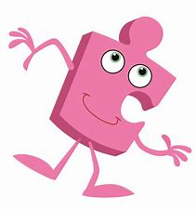
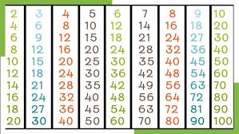
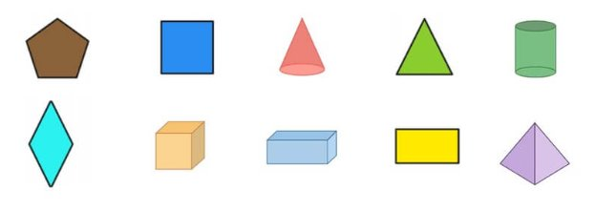
English This half term we will be focusing on the following books: Journey by Aaron Becker A Planet Full of Plastic by Neal Layton Clean Up! by Nathan Bryon In our writing, we will be working on writing sentences with different forms, the present tense, extending our sentences using coordination and subordination, and evaluating, rereading and proof reading our work. We will be writing a setting description and an explanation. Our Guided Reading text will be The Giraffe and the Pelly and Me by Roald Dahl. Spelling We will be focusing on the following spelling rules: The ‘l’ sound spelt –le, -el and -al at the end of words. Homophones and near homophones. Common exception words. Handwriting – Cursive We will be continuing to practise a cursive, joined handwriting style in writing across the curriculum,
Maths: Multiplication and Division and Shape To recall and use multiplication and division facts for the 2, 5 and 10 times tables including recognising odd and even numbers. To calculate mathematical statements for multiplication and division within the multiplication tables and write them using the multiplication, division and equals signs. To know that multiplication of 2 numbers can be done in any order and division of 1 number by another cannot. To solve problems involving multiplication and division, using materials, arrays, repeated addition, mental methods and known multiplication and division facts. To name some common 2D and 3D shapes and be able to describe their properties (number of sides, vertices, edges and lines of symmetry). To describe similarities and differences between different 2D and 3D shapes.
Science: Animals including Humans​ To notice that animals, including humans, have offspring which grow into adults.​ To find out about and describe the basic needs of animals, including humans, for survival (water, food and air).​ To describe the importance for humans of exercise, eating the right amounts of different types of food, and hygiene.
Spring 1 - Year 2
PSHE: Jigsaw Piece 3 - Dreams and Goals Goals to Success My Learning Strengths Learning with Others Group Challenges Celebrating Success
‘They are like trees planted along the riverbank, bearing fruit each season.’ Psalm 1:3

Slide 2
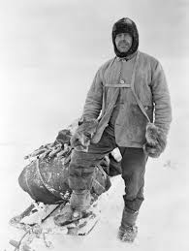
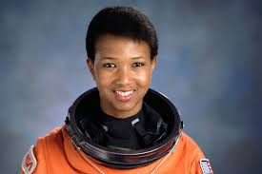
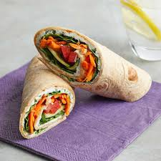




PE: Dance (Indoor) To remember, repeat and link actions to tell the story of my dance. To develop an understanding of dynamics and how they can show an idea. To use counts of 8 to help stay in time to the music. To copy, remember and repeat actions using facial expressions and character. To explore pathways and levels.
DT – Cooking & Nutrition: Balanced Diet We will be meeting the following objectives by making healthy wraps. To recognise food and their food groups. To identify the balance of food groups in a meal. To identify an appropriate piece of equipment to prepare a given food. To select balanced combinations of ingredients. To design based on criteria. To evaluate a dish based on design criteria.
History: How has exploration changed over time? We will be discussing and comparing the lives of Mae Jemison and Robert Falcon Scott, including their contributions to national and international achievements.
PE: Sending and receiving (Outdoor) To roll a ball towards a target. To be able to track and receive a rolling ball. To be able to stop, send and receive a ball with my feet. To develop throwing and catching skills. To send and receive a ball using a racket.
Music: Musical storytelling To explore listening and analysing a piece of music in relation to a story. To explore how music and sound effects can tell a story. To select appropriate sounds to match events, characters and feelings in a story. To suggest appropriate sounds to represent parts of a story. To perform a composition showing changes in tempo and dynamics.
Spring 1– Year 2
Computing: We are Photographers To understand what makes a good photo. To understand how digital cameras work. To develop skills in taking effective photos. To evaluate critically the photos I take. To edit and enhance my photos (use of Snapseed app).
RE: Islam- Prayer at home To describe the Muslim prayer routine and explain how Muslims believe this helps them in their everyday lives.
‘They are like trees planted along the riverbank, bearing fruit each season.’ Psalm 1:3

